Slide 1
Life Beyond the SIEM: Take Control of Your SOC with Jupyter
Ian Hellen - @ianhellen
Pete Bryan - @PeteABryan

Slide 2

Does Your SOC Look Like This?
This Photo by Unknown Author is licensed under CC BY-NC

Slide 3

Your SOC Might Be Making You Sad
Tied Down by your Tech?
Feeling Trapped as an Analyst?
Unable to Meet Quality Targets?
Not Sharing with your Team?

Slide 4

There is a better way

Slide 5
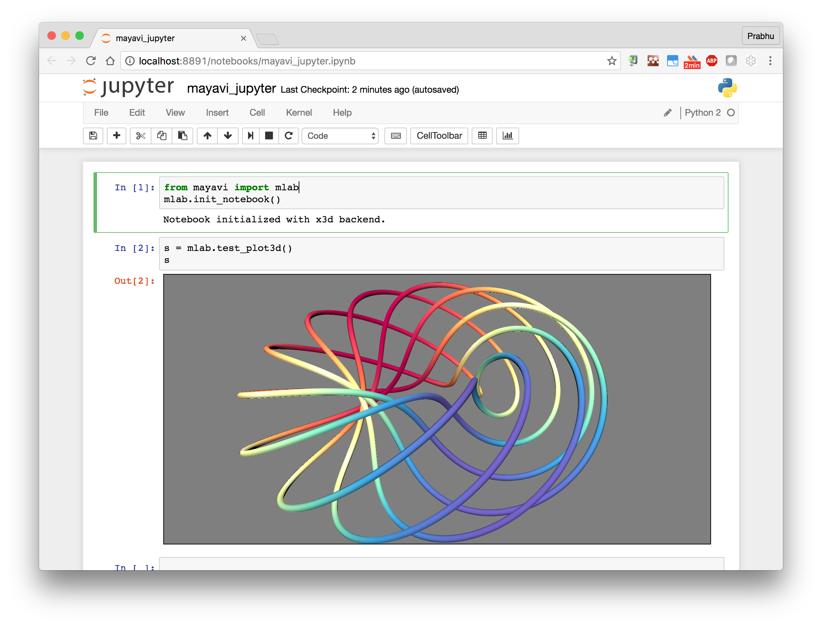
Introducing Jupyter for Security Operations!
Go beyond tool capabilities
Flexible for Analysts
Easy Integration
Repeatable Analysis
Sharable
Record
Community

Slide 6
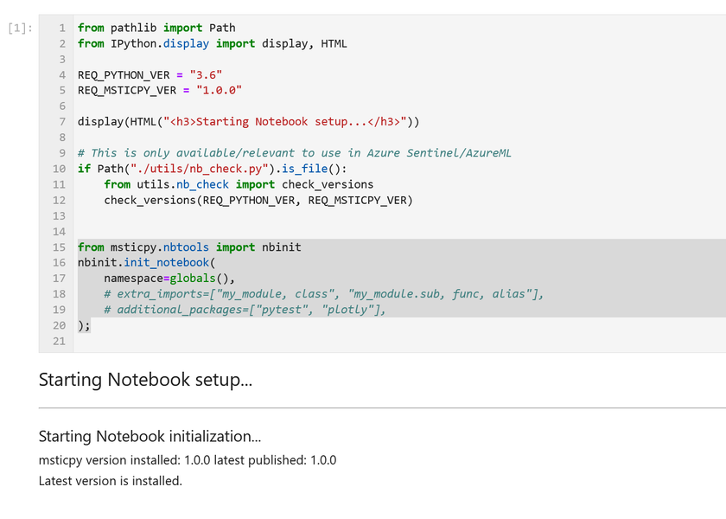
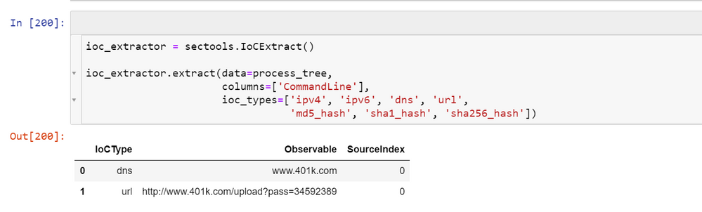
What is a Jupyter Notebook?
Open-source web application
Create and share documents that contain live code visualizations, and text
Support a range of languages including Python, R, Julia and PowerShell
Supported by VSCode, Azure ML, Google Collab and more
Notes:
One commonality we are seeing across teams is the adoption of using software to define and codify monitoring processes and practices
At the core of this area Jupyter Noteboks

Slide 7
Demo Time!
Notes:
Simple demo showing how a notebook can do something basic
Include demo of using request to query VT – lots of code

Slide 8
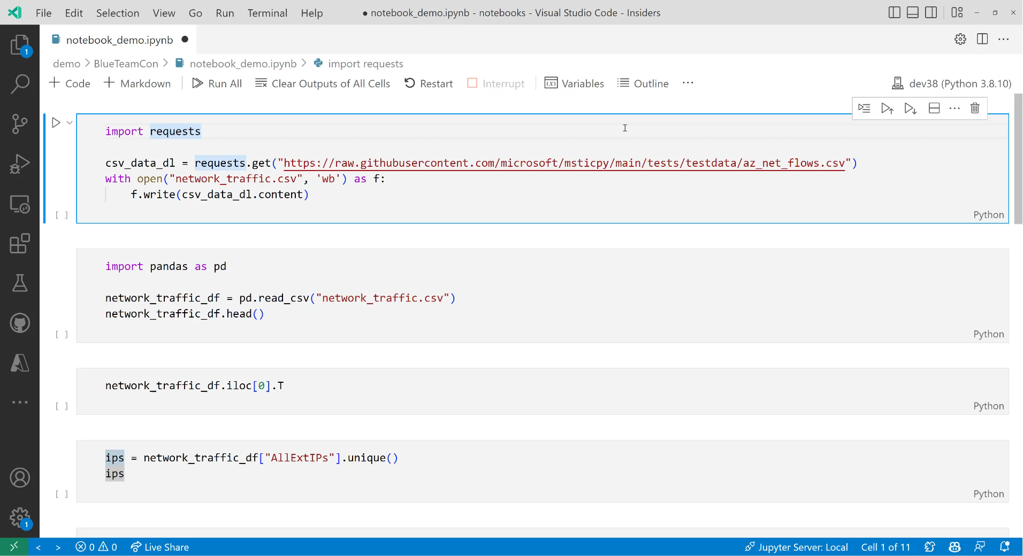

Slide 9
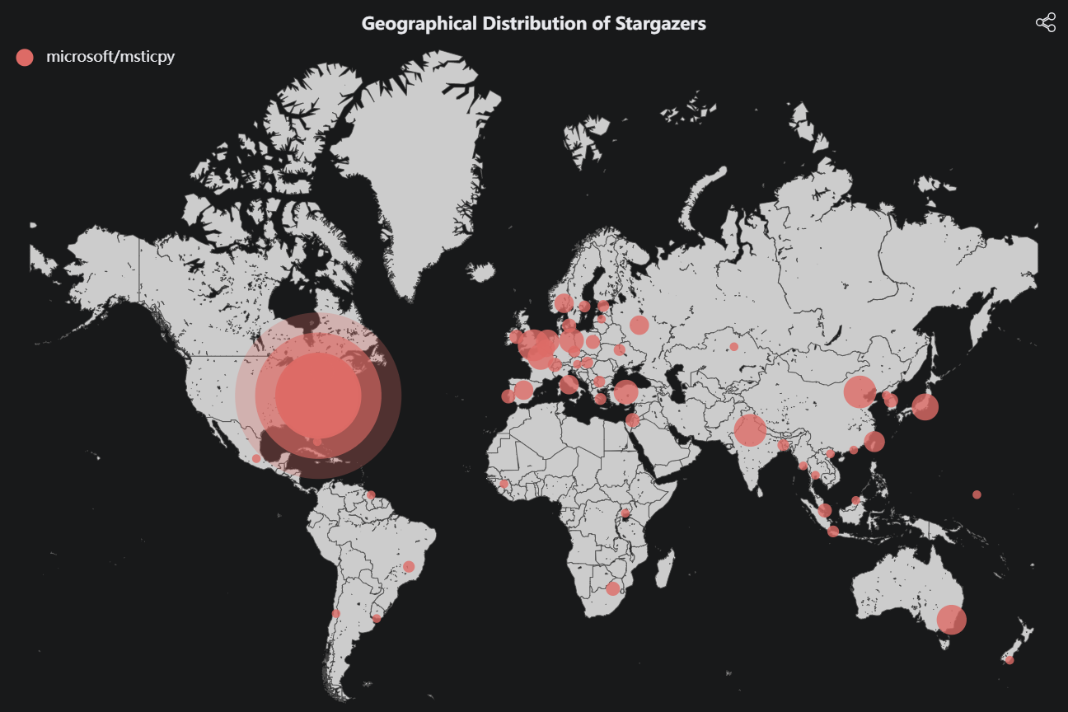
MSTICPy
Python package of security tools
Product Agnostic
Focus on minimizing code
Enabling analyst scenarios
Community Project
135k + Downloads
1000+ stars on GitHub
Range of contributors

Slide 10
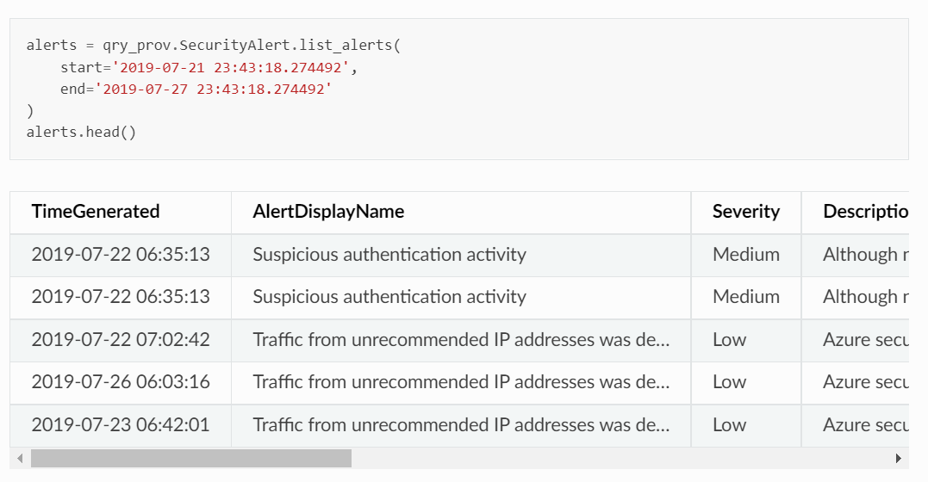
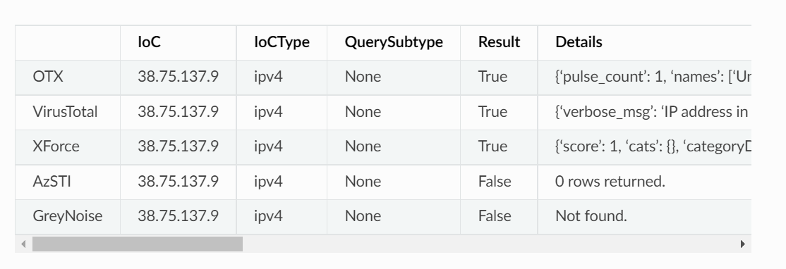
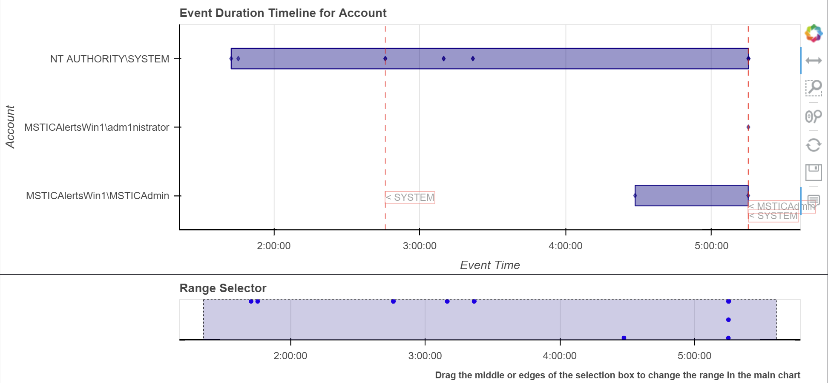
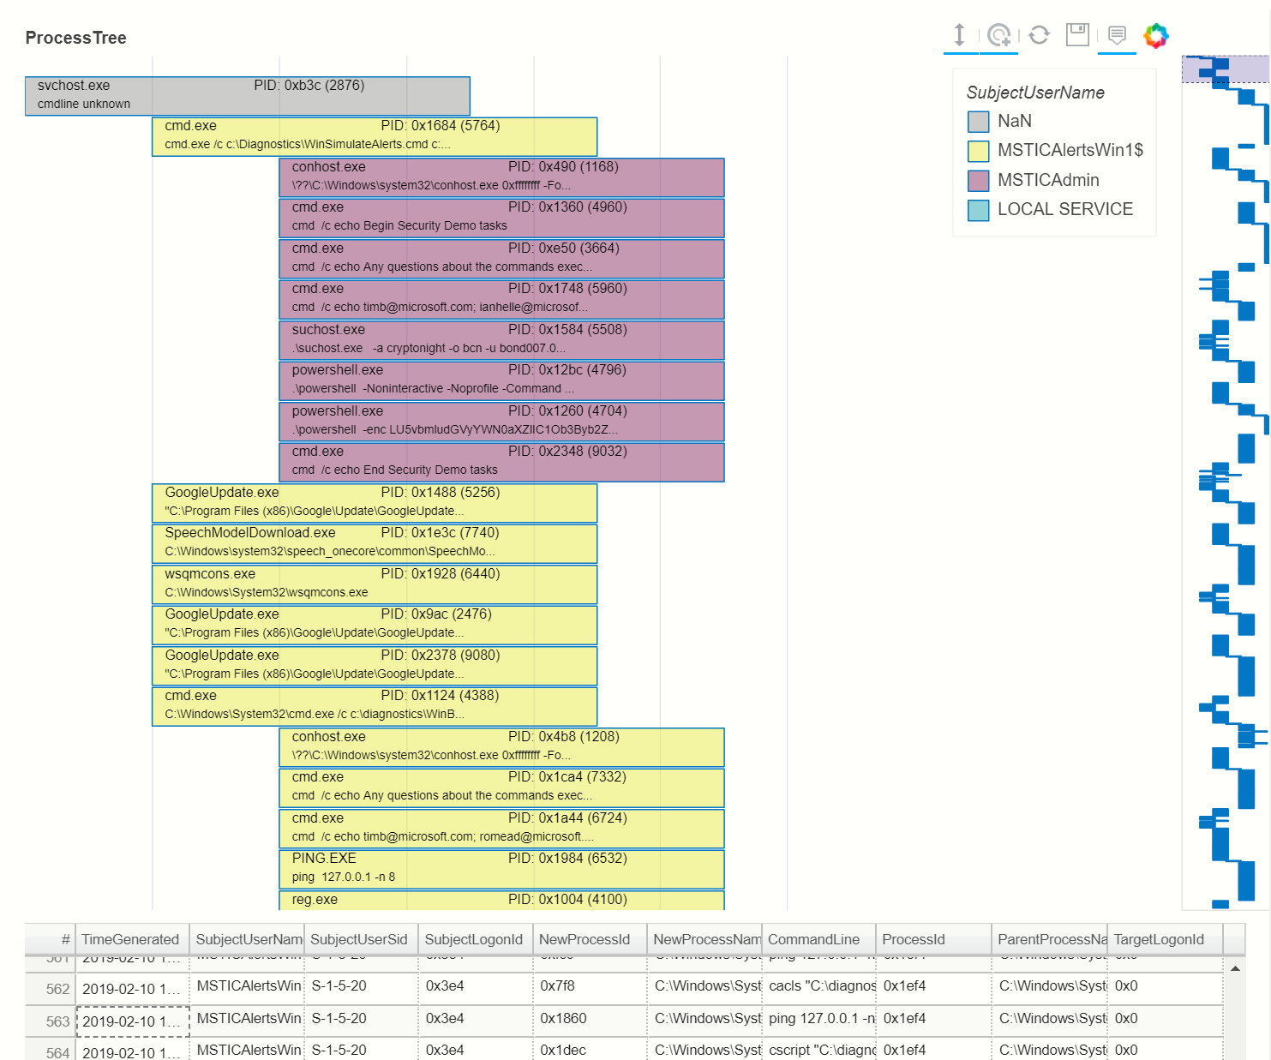
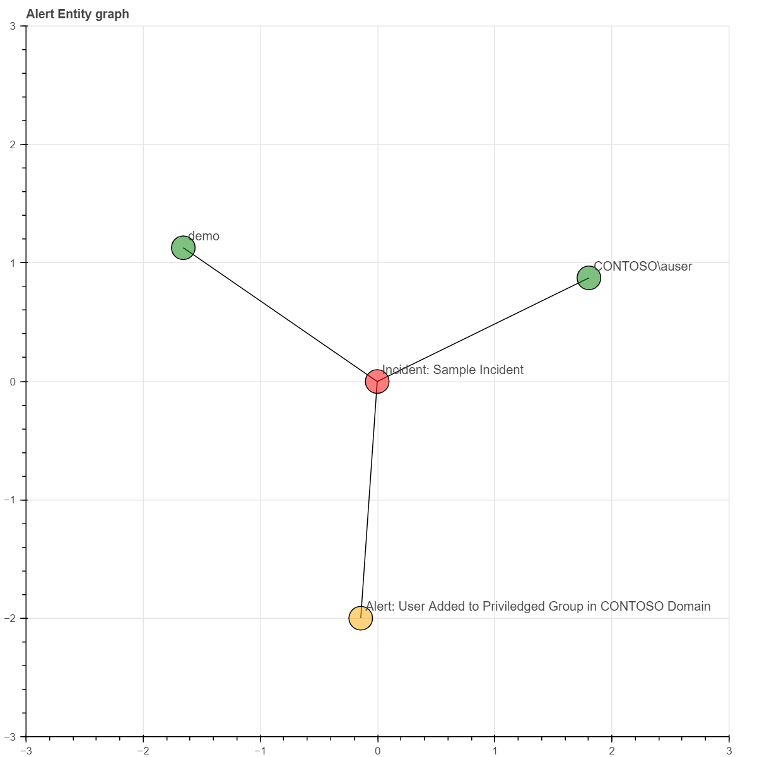
MSTICPy
Data Acquisition
Data Enrichment
Analyzing Data
Displaying Data

Slide 11
Demo Time!
Notes:
Simple demo showing how a notebook can do something basic
Include demo of using request to query VT – lots of code

Slide 12
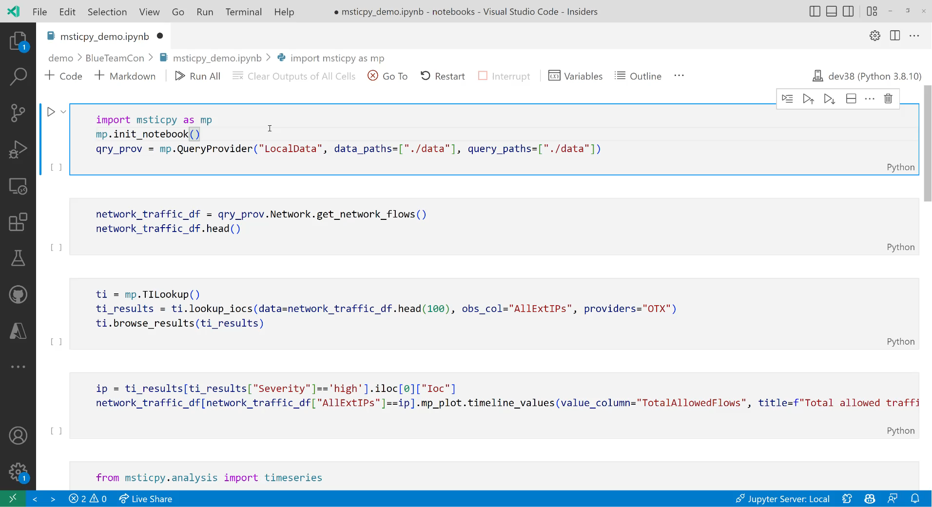

Slide 13
Challenges with using just notebooks
Hard to share
Skill set needed
Time to create
Version control
Authentication

Slide 14
Operationalizing Jupyter

Slide 15
Operating Model
Automating notebooks execution allows the SOC to benefit from
expert knowledge and process
Notebook Template
Inject Parameters
Trigger Execution
Store Output
Git
From SIEM
Papermill
Notebook Environment

Slide 16
Creating notebook templates
Version Control
Unattended Execution
Execution Options
Papermill parameters
Default execution path
Resilient to errors
Non-interactive
Notes:
Version Control – Git
Unattended Execution – paramerize, have default value for everything if not specified, ensure its non-interactive including auth, make it resilient to errors – it should output something if error is hit
Execution Options – Papermill, online service such as Synapse

Slide 17
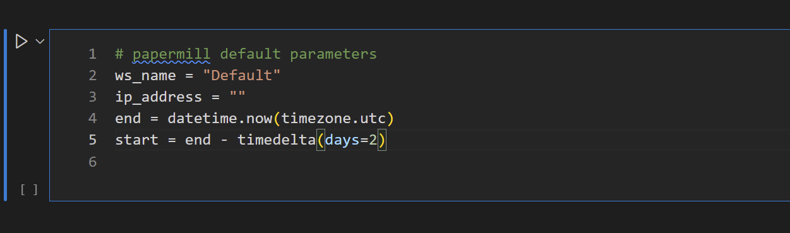
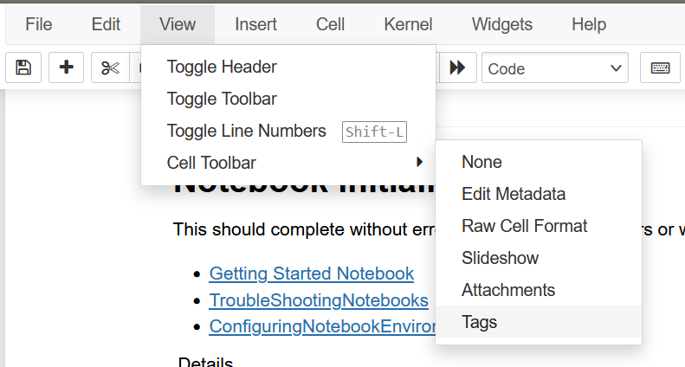
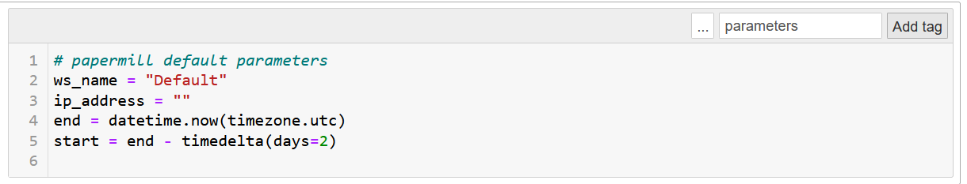

Adding Papermill parameters to notebook
Create template cell for parameters.
Some or all values can have defaults.
Create “parameters” cell tag.
Notes:
Version Control – Git
Unattended Execution – paramerize, have default value for everything if not specified, ensure its non-interactive including auth, make it resilient to errors – it should output something if error is hit
Execution Options – Papermill, online service such as Synapse

Slide 18
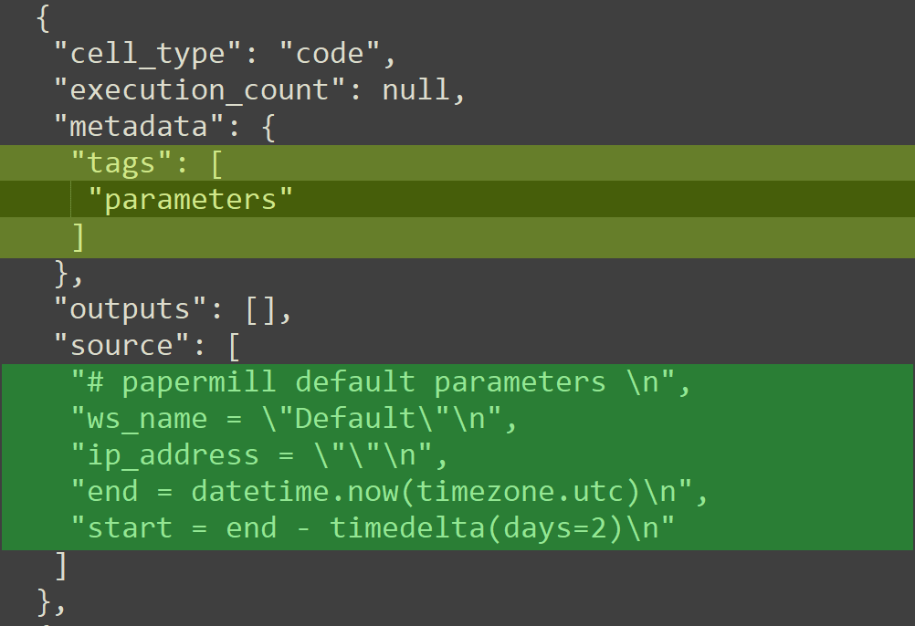
Parameters tag in raw (JSON) notebook
Add “parameters” to the “tags”
list

Slide 19
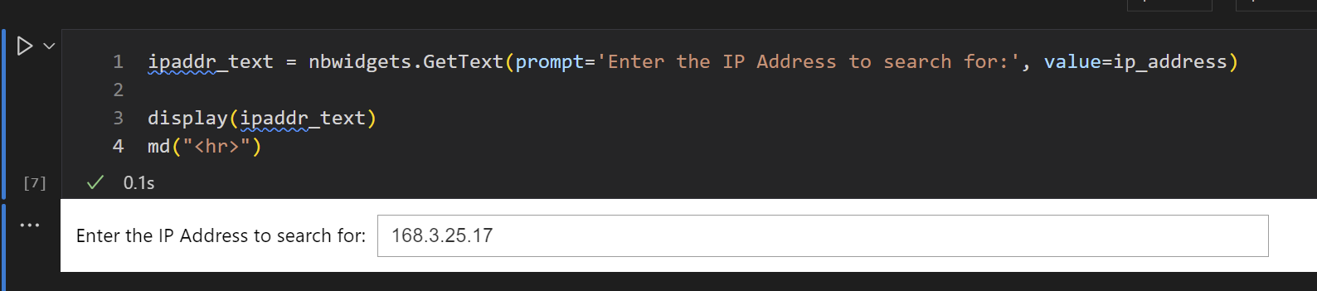
Allow interactive and automated use
Notebook parameter cell
Allow editing of parameters in non-blocking UI for interactive use

Slide 20
Injecting parameters
1. On the command line
$ papermill src/ip_addr.ipynb out/output.ipynb 
-p ip_address "128.1.2.3"  -p start "2002-07-01 13:05"  -p end "2002-07-02 13:05" 
2. In a yaml file
Ip_address: 128.1.2.3 start: 2002-07-01 13:05 end: 2002-07-02 13:05
$ papermill src/ip_addr.ipynb out/output.ipynb 
-f params.yaml
3. From Python
return pm.execute_notebook(
input_path=input_nb,
output_path=output_nb,
parameters=nb_params.papermill, # Python dict
**nb_kwargs,
)
Notes:
Scheduled
Notebooks can have statically encoded parameters
On demand - investigation/analysis tasks
Need a simple way of passing parameters – e.g. file drop or web form
Event triggered - incident/alert triage
Extract parameters from input and schedule execution
Polling is simpler – logic is all contained in notebook scheduler
Use web API or file drop to pass execution params
You may need all of these

Slide 21
Triggering execution
Scheduled - daily health checks, watch lists
On demand - investigation/analysis tasks
Event triggered - incident/alert triage
You may need all of these
Notes:
Scheduled
Notebooks can have statically encoded parameters
On demand - investigation/analysis tasks
Need a simple way of passing parameters – e.g. file drop or web form
Event triggered - incident/alert triage
Extract parameters from input and schedule execution
Polling is simpler – logic is all contained in notebook scheduler
Use web API or file drop to pass execution params
You may need all of these

Slide 22
Triggering - options
Use a cloud service
Roll your own
Build a trigger API
Databricks, Azure Synapse, Sagemaker, etc.
Cron/Windows job – schedule
HTTP endpoint
JSON parameters
Likely need to customize for event-triggering
File drop – on demand
Poller – event-triggered
Notes:
Papermill running a notebook
- Alternatives – DataBricks, Synapse
Environment setup:
- Python + packages
- Docker
Managing authentication and secrets:
- Managed identity – KeyVault (AWS and Google alternatives)
- KeyVault secrets – MSTICPy settings, manual retrieval

Slide 23
Execution - authentication and secrets
Authentication can be tricky
Data store (queries) Services (TI)
Use a cloud service identity
Store credentials in vault (e.g. Azure Key Vault)
Avoid passing secrets/credentials as Papermill params!!!
Notes:
Papermill running a notebook
- Alternatives – DataBricks, Synapse
Environment setup:
- Python + packages
- Docker
Managing authentication and secrets:
- Managed identity – KeyVault (AWS and Google alternatives)
- KeyVault secrets – MSTICPy settings, manual retrieval

Slide 24
Storing and retrieving results
Azure blob or AWS bucket
Cheap!
Output format
Create output folder structure and naming scheme to organize your outputs
Papermill can strip input code for easier reading
Create html copies for notebooks with findings (nbconvert)
/output/2022/08/01/ip-context_124_34_13_59_{UUID}_{date}.ipynb
Notes:
Saving output -
- organizing/naming
- persist URL to incident
- archive/age out

Slide 25
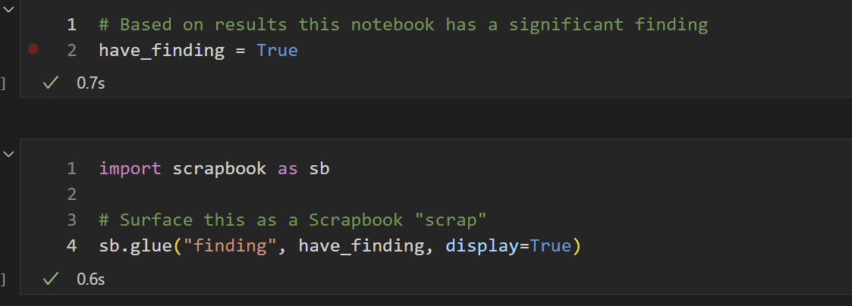
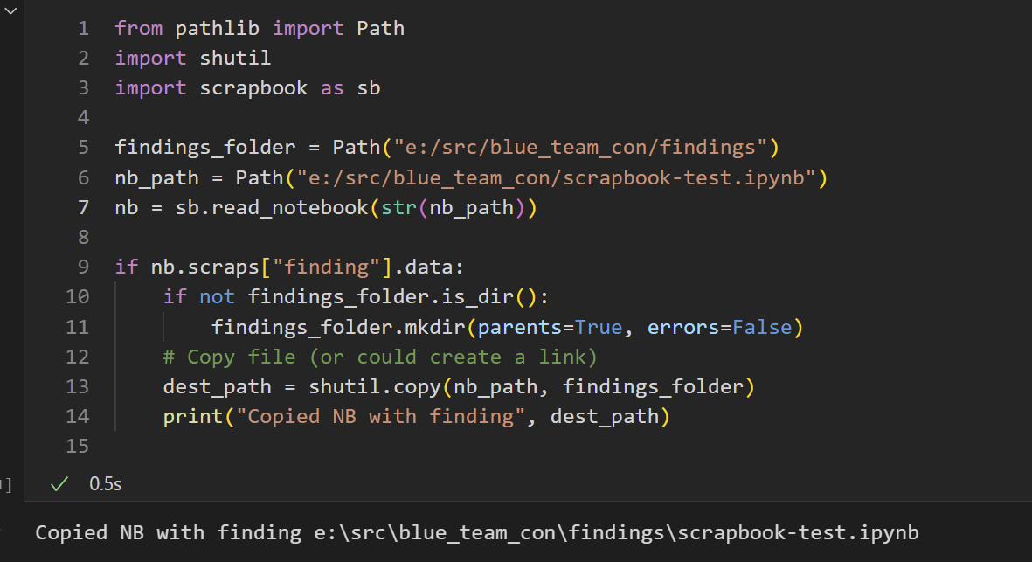
Storing output Identifying findings: nteract Scrapbook
Create a “scrap” in the source notebook:
Use scrapbook to check for presence of the scrap
Notes:
Saving output -
- organizing/naming
- persist URL to incident
- archive/age out

Slide 26
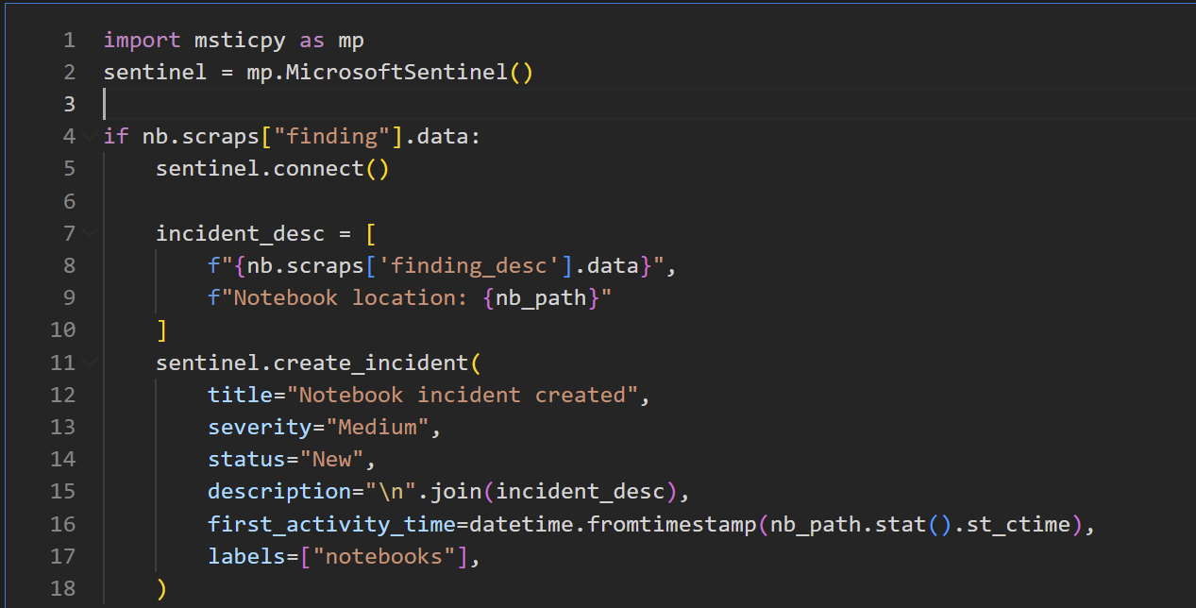
Storing output Identifying findings: create alert/incident
MSTICPy example for MS Sentinel
Most incident management systems have equivalent mechanism
Notes:
Saving output -
- organizing/naming
- persist URL to incident
- archive/age out

Slide 27
Putting it Together

Slide 28

Notebooks for Alert Triage
Triage Notebook Pattern
Alert Raised
Select Notebook
Auto Notebook Execution
Analyst Reviews Notebook
Incident Escalated
Next Analyst Reviews Notebook
Enrich Entities with TI
Adds context from inventory
Performs analysis steps
Incident Record Created

Slide 29
Notebook automation examples
Big brother of the demo
Software Defined Monitoring - Using Automated Notebooks and Azure Sentinel to Improve Sec Ops
Create Azure VM to run notebooks triggered from incidents
Should be adaptable to other cloud platforms
Our Demo
Simple solution using Docker + Papermill
Triggered by YAML parameters file
Full source on GitHub (see refs)
Notes:
Papermill running a notebook
- Alternatives – DataBricks, Synapse
Environment setup:
- Python + packages
- Docker
Managing authentication and secrets:
- Managed identity – KeyVault (AWS and Google alternatives)
- KeyVault secrets – MSTICPy settings, manual retrieval

Slide 30
Demo Time!
Notes:
Automated Notebook Demo – tied to process above
Get from Git
Parametrize
Run
Store
User Access

Slide 31
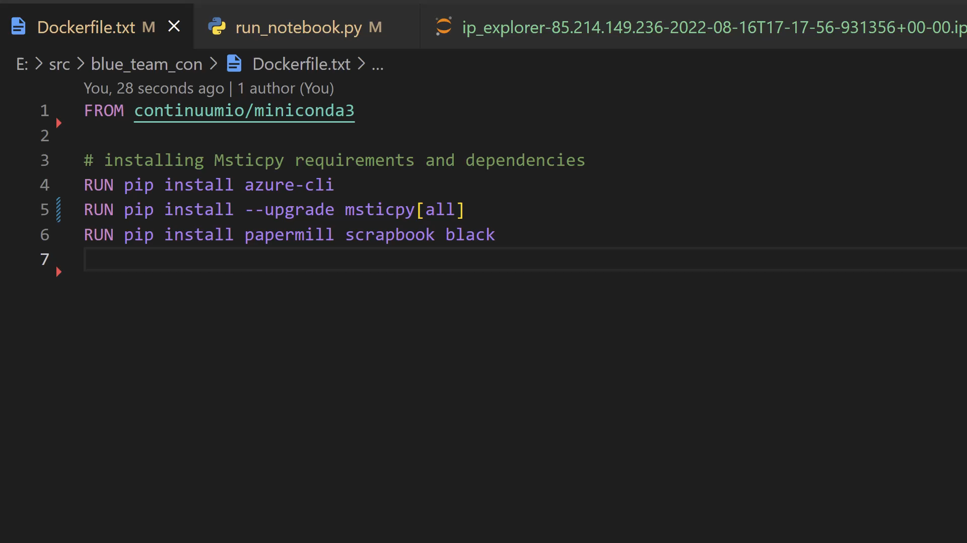

Slide 32
Notebooks for Threat Hunting
New Detections Created
Hunting Record
Hypothesis Not Proven
Detection Engineers Review Notebook
Develop Hypothesis
Develop Notebook
Test Hypothesis
Hunter Review Notebook
Threat Found
IR Team Reviews Notebook
Update Approach
Library Features
Incident Opened
Notes:
Animate this to show flow
Have demo of what notebook looks like at each stage

Slide 33
Threat hunting requirements
Usually ad hoc but may contain some automated elements
Library support is crucial – make it easy to:
Query and retrieve information
Create visualizations
Repeatable analysis and data extraction/transformation
Package common tasks in parameter-driven notebooks/notebooklets
Apply the same standards as automated notebooks:
Version control processes (for library and building-block code)
Output naming and storage
Notes:
Automated notebooks for hunting input – e.g. stamp TI watchlists

Slide 34
Why Jupyter is the Future of Your SOC

Slide 35


Why Jupyter is the Future of Your SOC
Better capability
Faster work
More resilient
More flexibility

Slide 36
How to get started
Local Notebooks
Shared Infrastructure
Shared Code
Automation
Process Integration
Full operationalization

Slide 37
Resources
Notebooks:
https://realpython.com/jupyter-notebook-introduction/
Jupyter
https://jupyter.org/install
MSTICPy
https://github.com/Microsoft/msticpy
Notebooks & Sentinel
https://aka.ms/SentinelNotebooks
This Presentation
https://aka.ms/BlueTeamConNotebooks
https://aka.ms/msticpy-demo

Slide 38
Thank you!
Ian Hellen - @ianhellen
Pete Bryan - @PeteABryan
MSTICPy - @msticpy

